Slide 1
Using Cloud to Accelerate Research
John Pearson
ResBaz Brisbane, Griffith University Southbank
June 7th, 2018

Slide 2

Disclaimer:
QIMR Berghofer has recently launched a spin-off company called genomiQa.
genomiQa (http://www.genomiqa.com) will provide precision analytics for next-generation sequencing.
Aspects of the QIMR Berghofer analysis and management processes and software for next-generation sequencing, including material shown in this presentation, are being commercialised via genomiQa.

Slide 3


Outline:
Cancer Genomics
Cloud

Slide 4
Outline:
Cancer Genomics
Cloud

Slide 5
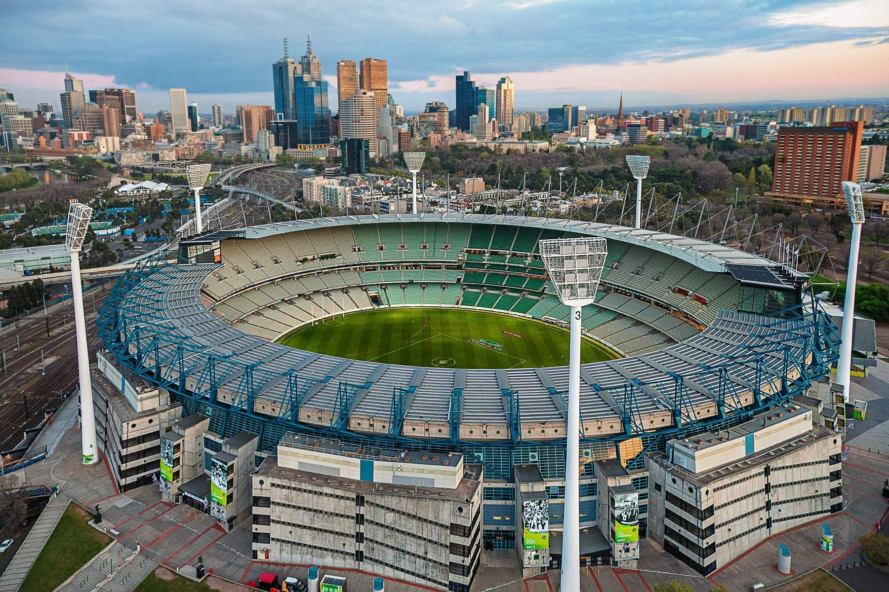
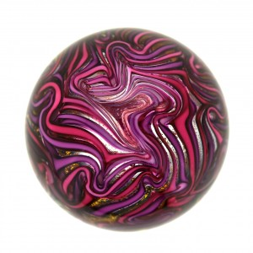
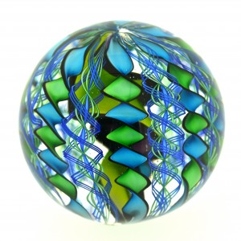

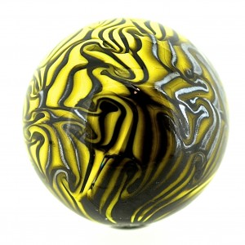
The Human Genome
Every cell in the human body starts with a copy of the human genome
The human genome is made of a chemical called DNA
We represent DNA as a string of 4 letters, e.g. ACGTTAAGCC…
The human genome contains 3 billion letters
In cancer, one or more of the letters change
A
C
G
T
MCG : 20,000 m²
Covered by marbles

Slide 6
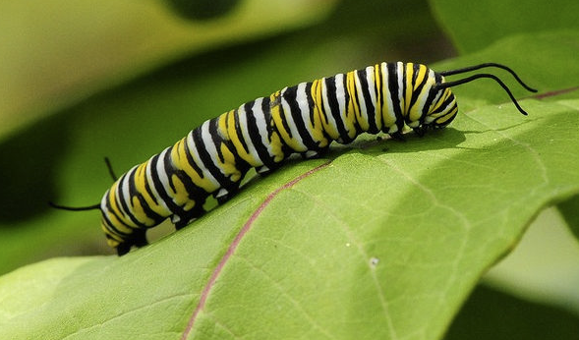

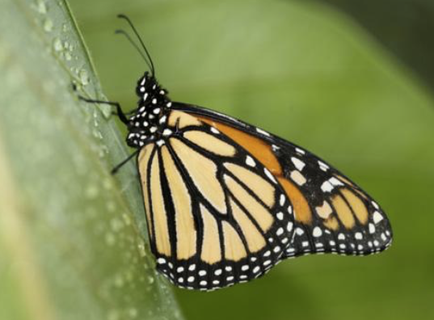


Genes are like Goldilocks – it has to be “just right”
The Monarch caterpillar and butterfly have exactly the same genome but different genes are turned on and off.
Each tissue in the human body does its different job because just the right genes are turned on by just the right amount and at just the right time.
Cancer happens when the wrong genes are turned on at the wrong time or by the wrong amount or are broken and make the wrong protein.

Slide 7
Detecting broken genes (mutations) in a cancer sample:
Human Reference Genome (Craig)
A
C
G
T
A
G
T
C
T
C
A
A
T
T
T
A
A
T
G
C
A
C
T
A
G
A
A
C
G
G
Bob’s Cancer Genome
A
A
G
G
G
G
T
T
A
A
G
G
C
C
C
C
T
T
C
C
A
A
T
T
A
A
T
T
T
T
A
A
A
A
T
T
G
G
C
C
A
A
C
C
T
T
A
A
A
A
A
A
A
A
G
G
G
G
G
G
Bob’s Normal Genome
A
A
G
G
G
G
T
T
A
A
G
G
C
C
C
C
T
T
C
C
A
A
A
A
A
A
T
T
T
T
A
A
A
A
T
T
G
G
C
C
A
A
C
C
T
T
A
A
A
A
A
A
A
A
G
G
G
G
G
G

Slide 8
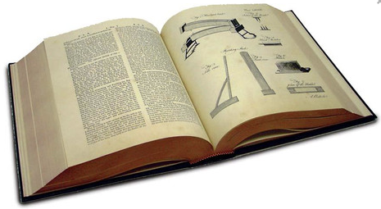
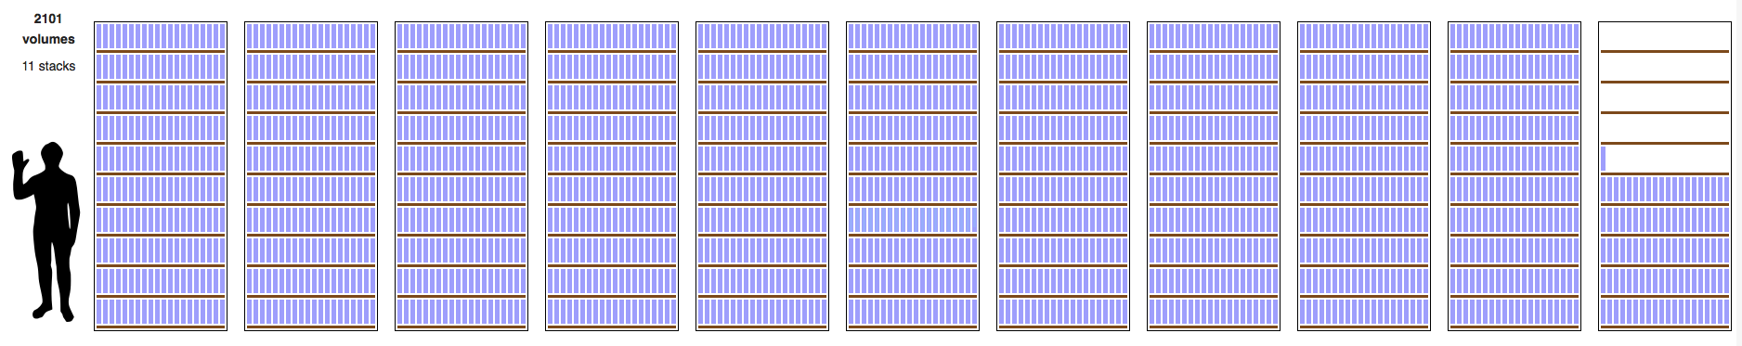
Genomics data sets are big – one patient:
A single patient’s cancer genome data: tumour sample @60x, normal sample @30x
300
gigabytes
x 37,500

Slide 9
Outline:
Cancer Genomics
Cloud

Slide 10
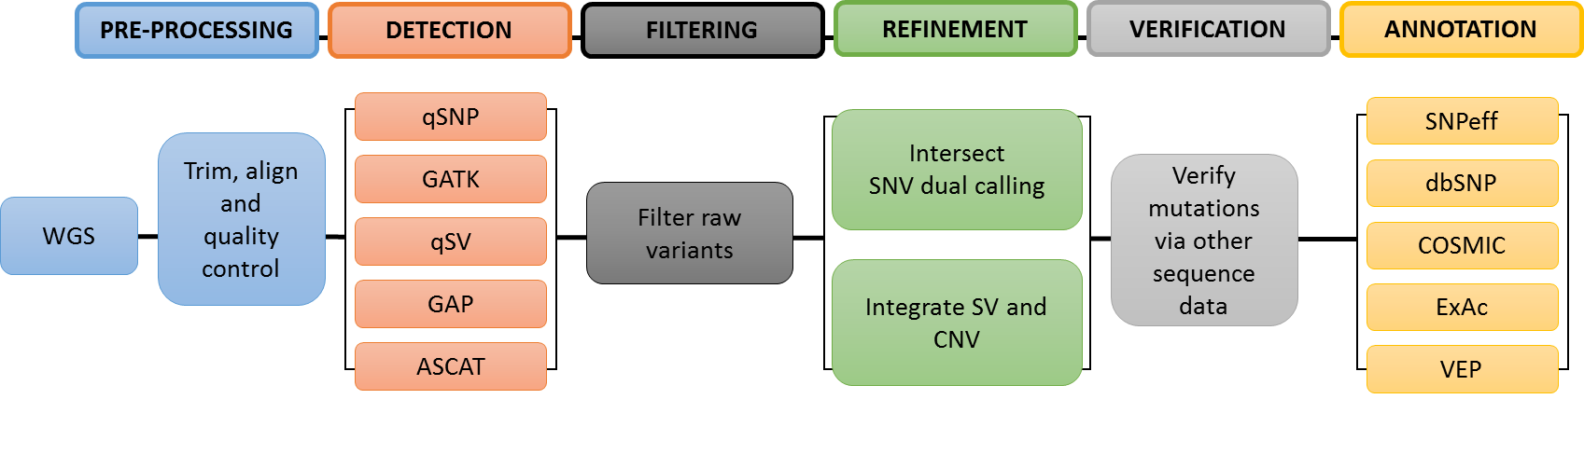
Our cancer somatic/germline analysis:
Approximately 30 pieces of software
500 jobs per tumour/normal pair
Jobs have to be run in a particular order and files and data must be passed between jobs
Workflows defined in WDL (Workflow Description Language)

Slide 11
Mapping – files and software view:
3
3
3
13
13
13
1
5
6
7
8
9
2
10
2
11
2
12
2
1
4
4
13
3
Files and software programs are shown as nodes and edges represent data flows. Files with a black square in the upper right corner are persistent while all others are ephemeral.
Files
Programs
FASTQ: reads from sequencer
BAM: aligned reads
XML: quality control report
BAM: from a parallel process
seqtk mergpe: merge pe reads
cutadapt: trim adaptors
bwa-mem: align to reference
samblaster: mark duplicates
samtools sort: sort BAM
qmerge: merge at library level
picard: mark duplicate reads
qmerge: merge at sample level
qprofiler: quality control

Slide 12
QIMR Berghofer compute cluster:
Compute
Disk
Tape
60 nodes
2 x 12 core Intel
256 GB RAM
4 x 1TB disks striped
1 x 10 GigE
1.4 PB Lustre
4 x OSS pairs
8 x 10 GigE per pair
2 redundant sites
30 kms apart
2.5 PB per site
10 GigE connection
Nightly updates

Slide 13
genomiQa Challenges
I don’t have money or space to build a server room
I don’t want to buy and maintain a lot of expensive compute and disk
I don’t want to pay for hardware while I’m not using it
I want to be able to use as much hardware as I need whenever I want
I don’t want to have to migrate data and software from old hardware to new hardware
I don’t want to be constantly patching my operating systems
I want data redundancy across multiple physical locations
If legal or practical concerns mean I can’t move data then I need to be able to move my analysis software to the data
I need to have encryption-at-rest and a heap of other security features
I want to be able to share certain data with certain people under certain conditions and for certain timeframes

Slide 14

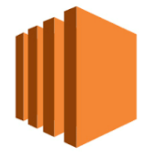


AWS Architecture 1: Cluster-on-cloud
Research-scale Analysis
genomiQa’s first cloud analysis solution uses a traditional computer cluster created and configured on AWS plus separate AWS permanent storage.
Data files move into the cluster from S3 storage and results files move out of the cluster to S3 storage.
Compute
Storage
Storage
Cloud
Formation
Database
Scheduler
EC2
EBS
S3
EC2
EC2

Slide 15
AWS Architecture 2: Single-use Analysis Units
Nation-scale Analysis
genomiQa’s redesigned cloud solution creates a new single-use dedicated analysis unit for each sequencing analysis job. Each analysis unit has its own EC2 compute and EBS storage. AWS services are used to house the database which controls the system.
Data and results files are written to and from S3 storage while control information moves to and from the database.
Storage
Database
Analysis Unit
S3
EC2
EC2
EBS

Slide 16
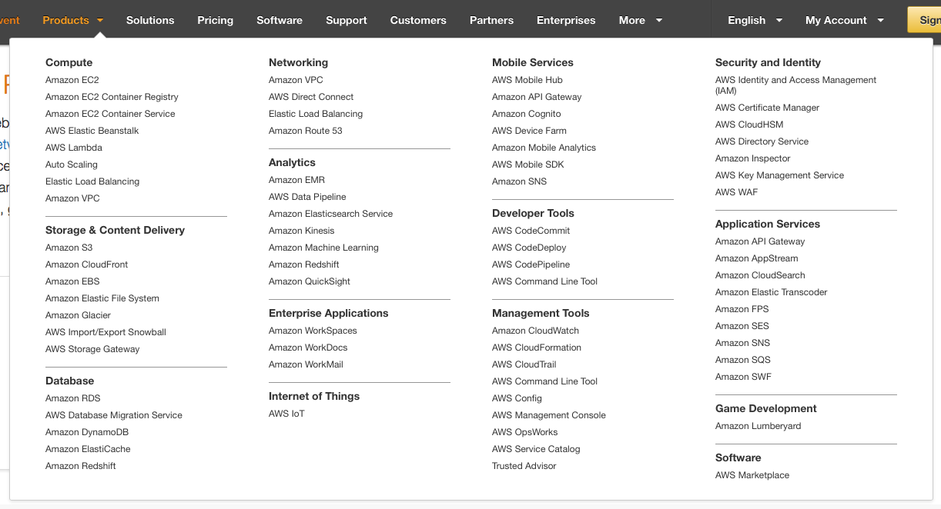
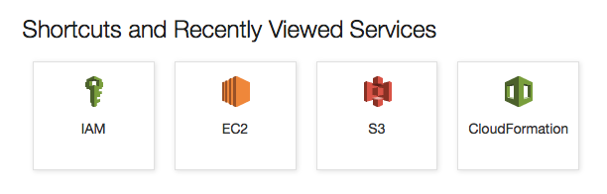
Lesson 1 – the AWS ecosystem is not as scary as it looks:

Slide 17
Lesson 2 - how much of your software stack do you control?
3
3
3
13
13
13
1
5
6
7
8
9
2
10
2
11
2
12
2
1
4
4
13
3
We thought our software stack was a well understood system but we found a number of 3rd party software packages that behaved badly under cloud conditions including I/O problems, and constrained operating system versions.
QIMR Berghofer software
3rd party software

Slide 18
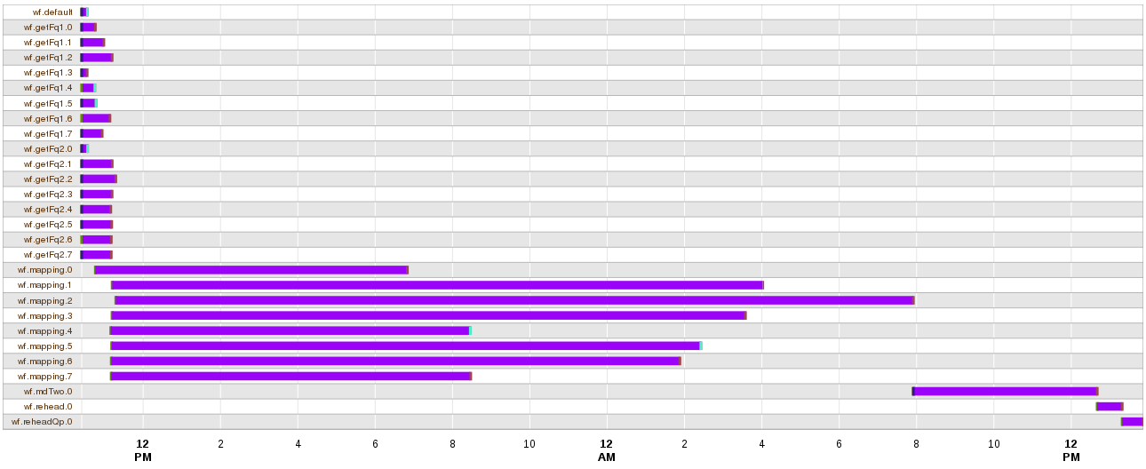
Lesson 3 – scheduling and resourcing is not a problem:
Report from our scheduler showing start and end times of jobs.
AWS autoscaling every 5 minutes successfully grows and shrinks our cluster-in-the-cloud so that we minimise unused EC2 instances.

Slide 19
Lesson 4 – decouple processes from database:
Cluster
Cloud
Job 1
DB
Job 2
DB
1
Job 1
Job 3
2
Job 2
Config
Job 4
3
Job 3
Every cluster node can see the database server and every job reads and writes to the database.
4
Job 4
The database is used to generate a configuration file which every job reads from. Jobs also write reports and at the end of the process, the reports are parsed and used to populate the database.

Slide 20
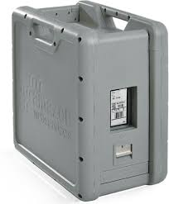
Lesson 5 – consider AWS snowball for large data transfers:
Cluster
Snowball
Submitting sequencing data (BAM files) to the EGA repository in the UK was problematic:
70 TB typically took 2-3 months to do
the connection dropped out multiple times per day
a staff member was disrupted for the entire period as they monitored the transfer, restarted dropped connections and cleaned up partial transfers
we ended up buying and shipping boxes of bare disks
$200 to rent a 80TB snowball device
30 TB of BAM files took 2 days to upload to snowball
Shipped snowball to Sydney where AWS unloaded the data to S3
The transfer from AWS Sydney to the EGA in the UK took 3 days

Slide 21
Lesson 6 – organisational cultural change is required:
Capital expenditure on hardware is a well understood process:
tender, procure, receive, install, manage, decommission, dispose
Hardware-as-a-service is not a well understood process:
There is no control via the tender and procurement phases
There is no control via a legally binding SLA with the vendor
There is no control via receipt of goods
There is no control via allocation of assets
There is limited control over finances because billing occurs after expenditure
Funding bodies and grant reviewers will need to understand and allow for budgets to be built around purchases of services rather than goods

Slide 22






Acknowledgements:

